Slide 1

Cases from the Clinic
Jo Szram
Carl Reynolds

Slide 2
Reasons to be breathless: when is fibrosis occupational?

Slide 3
A “typical” case
80 year old man
exertional breathlessness
fine crackles
asbestos exposure
High resolution CT chest:
Can you spot two abnormalities?

Slide 4
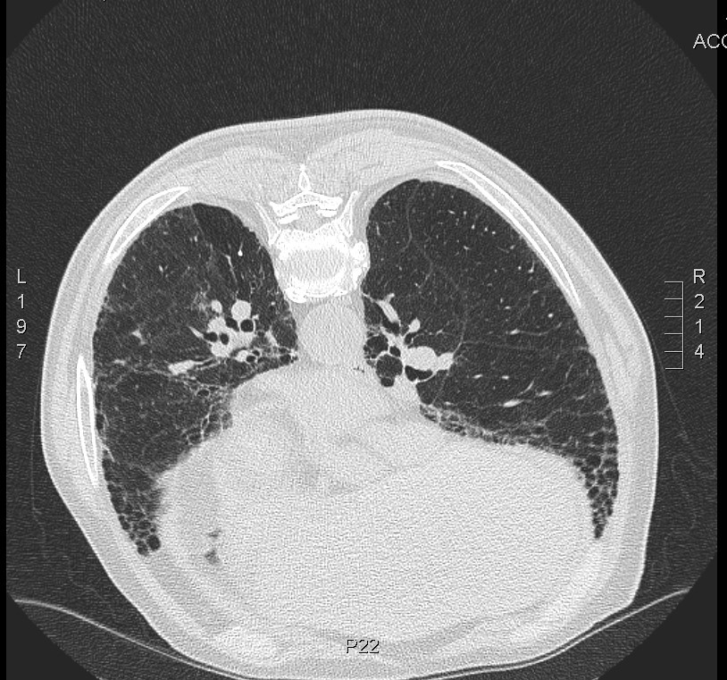

Slide 5
CT findings – “official report”
extensive coarse reticular shadowing most marked in the lower lobes extending into the upper lobes.
calcified pleural plaques over the left hemi diaphragm
no other abnormality
“The parenchymal changes are more suggestive of IPF rather than asbestos-related interstitial lung disease although I cannot exclude this."

Slide 6
Occupational (and other relevant) History
worked as industrial lagger in power stations and railways for 40 years
wife has pleural plaques
IPF or asbestosis?

Slide 7
Another “typical” case
New patient in ILD clinic
6/52:
productive cough
breathlessness on exertion
generally unwell.
rescue pack of doxycycline and steroids with no improvement.
Tachycardic
coarse creps to mid zones bilaterally
WCC 24 CRP >480
Admitted for inpatient treatment

Slide 8
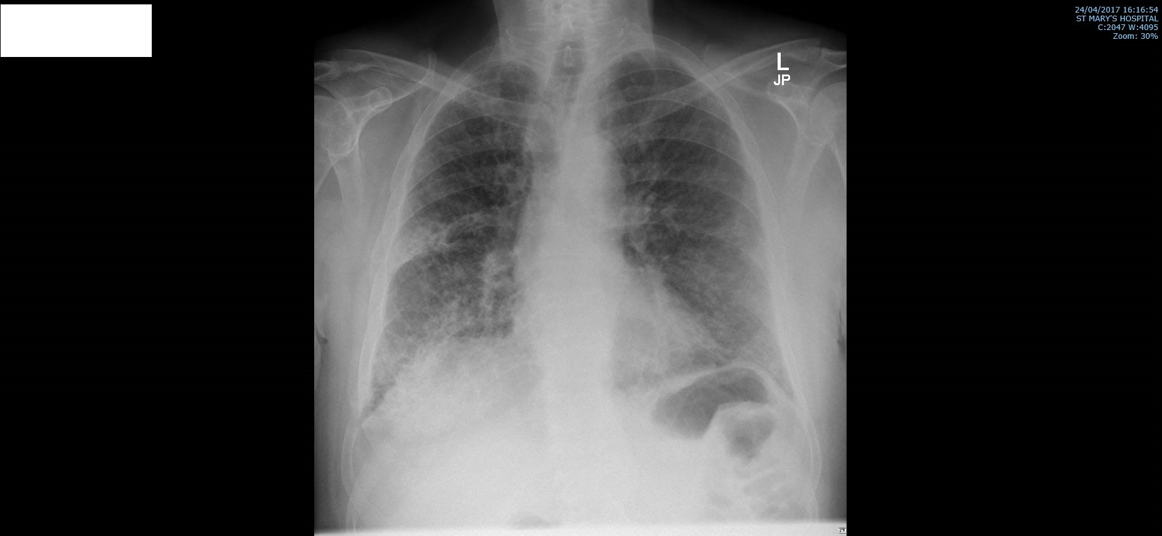

Slide 9
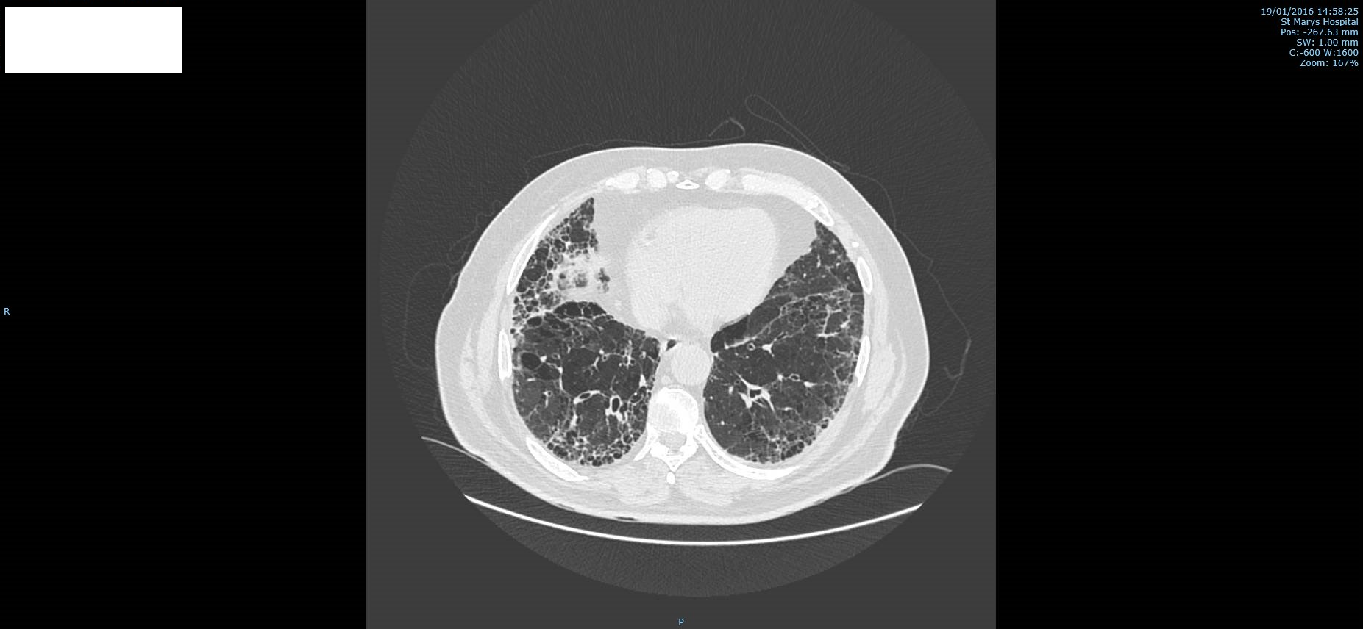

Slide 10
Recent series of diagnoses
2016
January Seropositive erosive rheumatoid arthritis (on rituximab)
UIP - Usual interstitial pneumonitis
February Emphysema
May small segmental pulmonary emboli
Pre 2016
COPD
Hypertension
Type 1 DM
“mild” restrictive spirometry
FVC 2.9 L (71% predicted)
diffusion capacity 35%
(severe impairment)

Slide 11
Occupational (and other relevant) history
retired carpenter
recalls cutting up asbestos board 2-4xmonth for several years
50 pack year smoking history
UIP or asbestosis?

Slide 12
UIP and asbestosis – some science from Carl
Background to your study
Put some useful clinical pointers in
Message is:
Not all chest physicians will think of asbestos even when faced with pleural plaques
Link between UIP and asbestos exposure may be more complex than previously thought (or something like that)
Careful occupational history is very important in these cases

